Slide 1
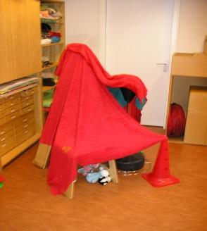
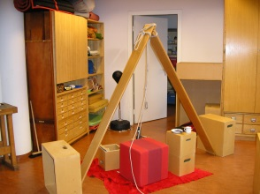
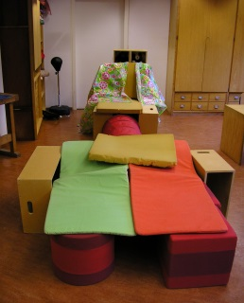
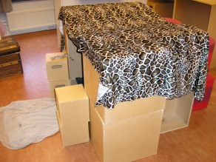
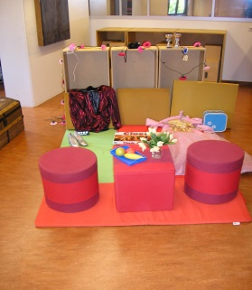
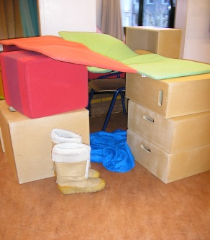
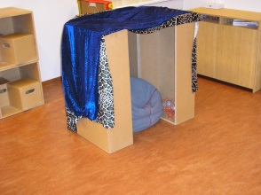
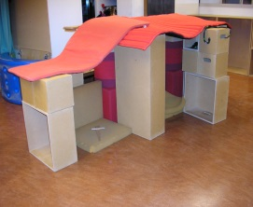
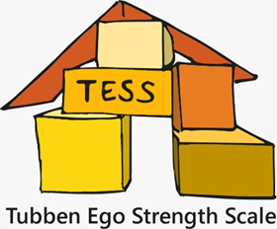
We’re going to build a hut!
And an assessment tool!

Slide 2
TESS
Administering
Show round the room
Building of the hut
Decorating the hut
Role figures and story
Acting out the story told by play on demand

Slide 3
practice based knowledge
Measured concept?
Ego Strength
4 levels of expression
product
process
giving meaning
thematic play

Slide 4
developmental dimensions based on psycho-social model of Erikson
Ego Strength
Basic Trust
product
process
giving meaning
thematic play
Autonomy
product
process
giving meaning
thematic play
Initiative
product
process
giving meaning
thematic play
Industry
product
process
giving meaning
thematic play

Slide 5
the TESS Structure of the score form with developmental tasks and developmental skills
Making
Contact
EGO STRENGTH
Taking
Space
Inte-
grating
Basic Trust
product
process
giving meaning
thematic play
Autonomy
product
process
giving meaning
thematic play
Initiative
product
process
giving meaning
thematic play
Industry
product
process
giving meaning
thematic play
Notes:
With an expert panel observable items are formulated for every cell
Then it turned out to be impossible to just describe one observable item, most of the time we had three and couldn’t choose. (basic trust x product: size of the hut- entrance- shelter) And I can tell you they all became rather agitated, and I could only avoid a conflict by promising I would take a closer look and see if I could keep all the mentioned observable items in the tool.
I could distinguish a structure of three developmental skills: Taking Space, Making Contact and Integrating
All these scales are measured on the four levels of expression. So the assessment tool had 48 cells, in each cell an observable item is formulated, for example:
‘Size of the hut’ (basic trust x taking space, product). Or ’is the observer given entrance into the hut’: (initiative x making contact, thematic play).
The observable items are scored on a 7-points scale from: is extremely the case (7) till is extremely not the case (1). A manual provides guidelines for scoring.
The TESS is administered by children from 7 up and including 12 years old

Slide 6
National Research
Aim
To set up a standard or norm score
To validate both the overall scale
Ego Strength as well as the subscales from the TESS

Slide 7
Norming Study
17 drama therapists from all over the country are schooled in administering and scoring of the TESS
Interrater reliability ICC>.80 as admission requirement
Overall scale Ego Strength ICC = .85
Subscales vary between ICC .78 and .86
ICC Type absolute Agreement

Slide 8
Norming Study
Normative sample of >400 children
Representative sample
From all over the country
From different school types or education systems
Equal amount boys\ girls
Equal amount younger and older age
7, 8 and 9 years old
10, 11 and 12 years old

Slide 9
Validity study
Data analysis
Comparing scores on the TESS to scores on validation tools
Seeking ‘best model of fit’ to ground the internal structure of the TESS
Comparing scores of the normative sample to scores of the clinical sample
Notes:
no suitable instrument at hand, a hard hurdle to take
with the 100 cards of the CCQ (Californian Child Questionnaire) I constructed an expert profile ego strength (a time consuming exercise)
So now I could compare the laid profile by a teacher for a particular child with that of the expert profile Ego Strength. This outcome I could correlate with the outcome on the TESS.

Slide 10
Differences between
girls and boys
Norm sample
Eta²=.014 , a small effect

Slide 11
Differences between
age groups
Norm sample
Eta²=.021, a small effect

Slide 12
Differences between
Norm sample & cliënt sample
Norm sample N = 398
Cliënt sample N = 127
Eta²=.095, a reasonable effect
Cohen’s d=.75, a large effect

Slide 13
Outcome
psychometric study
the structure of the TESS in one overall scale and seven subscales is confirmed
5 items were removed, so all psychometric outcomes had to be recalculated ☹
the overall scale Ego strength is valid and reliable.
Construct: bi-factorial analyses in Mplus
Convergent: correlation CCQ and TESS = .42
Criterium: difference norm and client sample
the subscales are all reliable, the evidence for validity was ambivalent, so it is best to formulate therapy goals based on subscales as working hypotheses.
Adequate standards are made by which an individual score can be compared with the average score of the norm sample.
Notes:
construct validity confirmatorische bi-factoranalyse in Mplus 7.4
convergent validity correlation .42 between at the one hand the score on the TESS and at the other hand the CCQ ego strentgth profile made by a teacher in the classroom.
Criterium validity Difference norm sample and client sample

Slide 14
Value of the TESS
The TESS discriminates between children with and children without clinical problems.
Ego strength plays an important role as it comes to clinical problems and therefore you can see ego strength as a transdiagnostic factor
Score patterns on the TESS give guidelines
for treatment

Slide 15
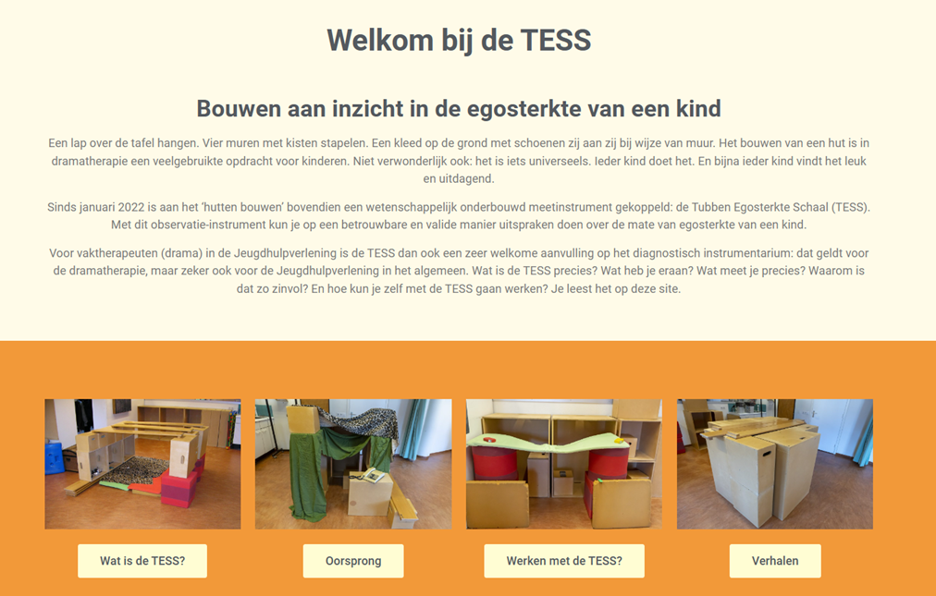
TESS in practice
Log in on www.detess.nl

Slide 16
TESS in practice
If you have a TESS certification:
Go to my TESS environment
Open a TESS score form
Fill in the administration details
Fill in the score form
Score each item on a 7-point scale
Check for each item the guidelines for scoring
Check if every item has a score filled in
Push the submit button
And an Analysis rolls out

Slide 17
TESS in practice
Analysis explained
You find:
first the administration details
Second a percentile norm score for Ego strength is measured
Followed by a general description belonging to children with this amount of ego strength
Thereafter the scores on the subscales in colour
Then the pattern of the scoring on the subscales
Last a general explanation of the score pattern

Slide 18
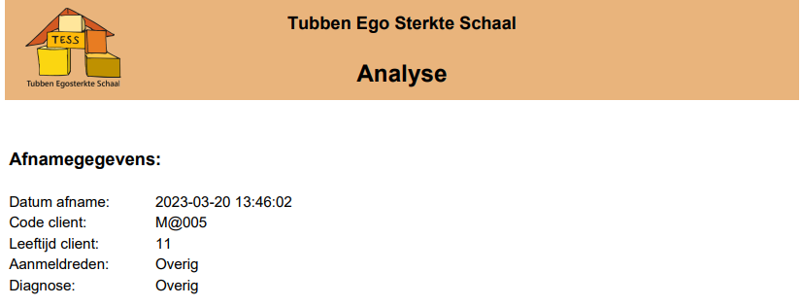
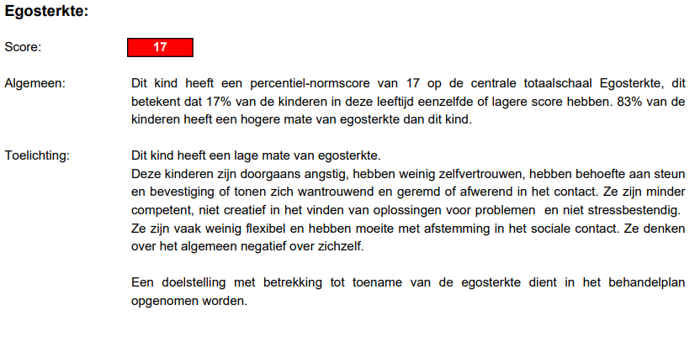

Slide 19
TESS in practice
Analysis explained
Example of a Peak Pattern (next slide)
The scores on the subscales differ largely
Provides guideliness for treatment goals
Risk of overestimating a child

Slide 20
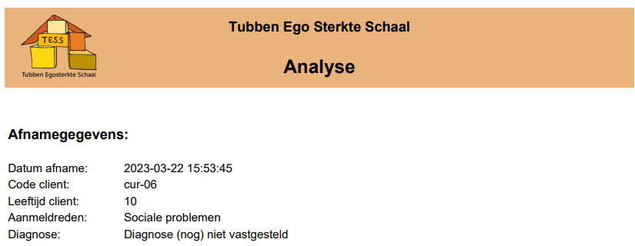
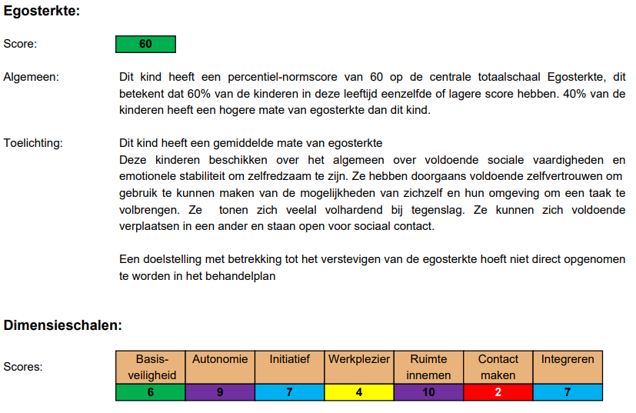
Notes:
Whimsical pattern

Slide 21
TESS in practice
For drama therapists:
so inspiring and rewarding and exciting to work with
Every hut is different Outcome is clear
Guidelines for treatment goals
For colleagues:
Growing ask for TESS administrations of colleagues from other disciplines because easy communication about the outcome
For clients:
Doesn’t feel like being measured, for most of the children it is play and fun
For parents:
Gives detailed insight and better understanding of (the psycho-social development of) their child

Slide 22
Education on the TESS
At all 5 courses for drama therapy
About diagnostics in therapy
In a broader sense
in drama therapy
Training the students in use of the underlying theoretical principles of the TESS
Observation on the four levels of expression
Play on demand (directed by child)
Research skills
Curiosity
Perseverance: step by step
Motivation by example
Notes:
descriptive diagnostics: what is the mater with this child
Explaining diagnostics: why is this the matter, underlying cause
Indication diagnostics: what treatment is best
Evaluative diagnostics: how succesful is this treatment: as the treatment the expected outcome

Slide 23
Education on the TESS
TESS Course for drama therapists
Theoretical framework of the TESS
Of the used constructs
Of the psychometric features of The TESS
Training the drama therapists in use of the underlying theoretical principles of the TESS
Observation on the four levels of expression
Play on demand (directed by child)
Training the drama therapists in administering and scoring of the TESS

Slide 24
Education on the TESS
At the end of the course there will be an individual exam in which two aspects will be assessed:
TESS administration according to protocol
Interrater reliability ICC ≥ .80
type absolute agreement
If you pass the exam, you get certified and are licenced to use the TESS for two years without any costs.
After two years a check on the Interrater reliability will take place… and after that you can use the TESS for free…
for ever ☺

Slide 25
So…
Long live the TESS
I’m so proud of my brainchild!!!!

